Slide 1
Kooth
If you’re age 10-25 and feeling worried, anxious, stressed or frustrated,
get some support at:
www.kooth.com

Slide 2
Hertfordshire Mind Network’s ReachOut Service
Notes:
The ReachOut Service from Hertfordshire Mind Network is for young people aged between 10-17 or their parents/caregivers for support with any issues affecting their wellbeing. Instant message at www.hertordshiremindcyp.org or call on 01923 256391 option 2 on Mondays to Thursdays 5pm-8pm.

Slide 3
Just Talk Hertfordshire
If there’s something on your mind, Talking Shows Strength

Slide 4
Just Talk Hertfordshire Five Ways to Wellbeing E-learning modules

Slide 5
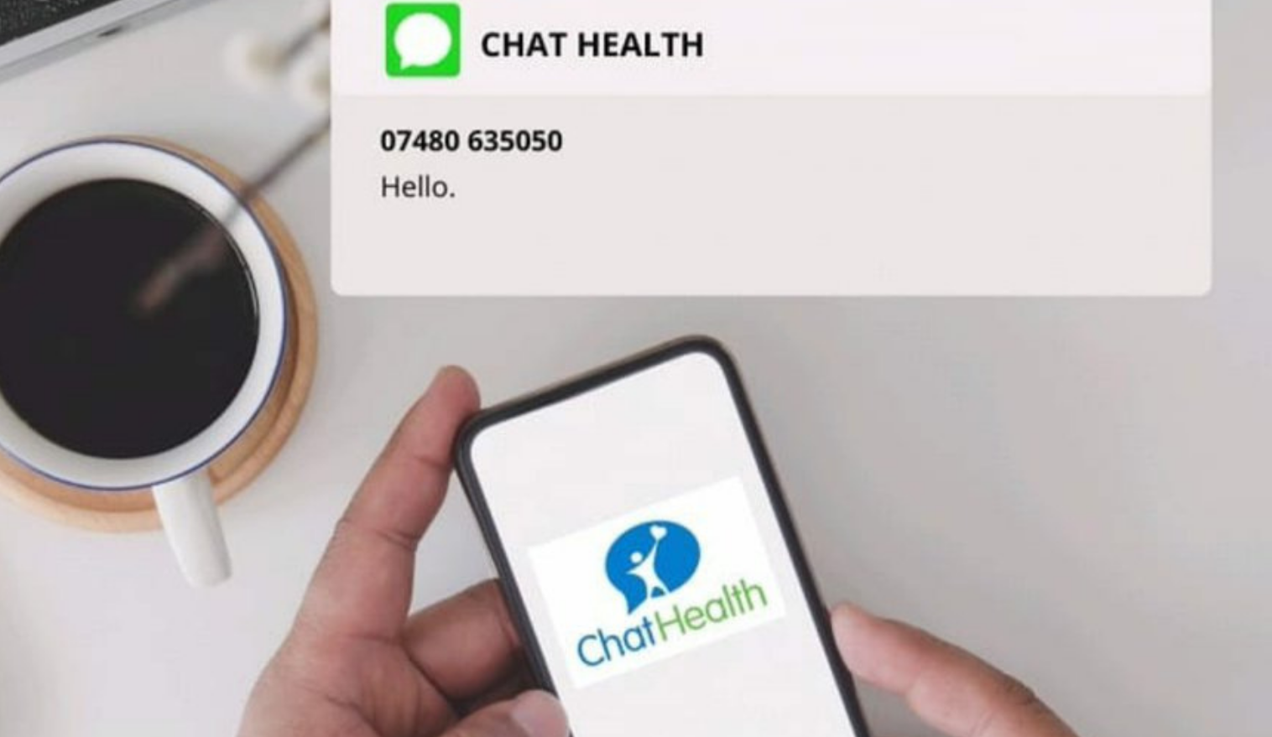
ChatHealth Texting Service for 11-19s
It’s easy for 11-19s to text a School Nurse at ChatHealth
for confidential & safe wellbeing advice

Slide 6
Services for Young People
Information, advice, guidance, work related learning and emotional support for young people at:
0300 123 7538

Slide 7
Health for Teens website
Healthy body & mind topics by experts for 11-19s at:
www.healthforteens.co.uk

Slide 8
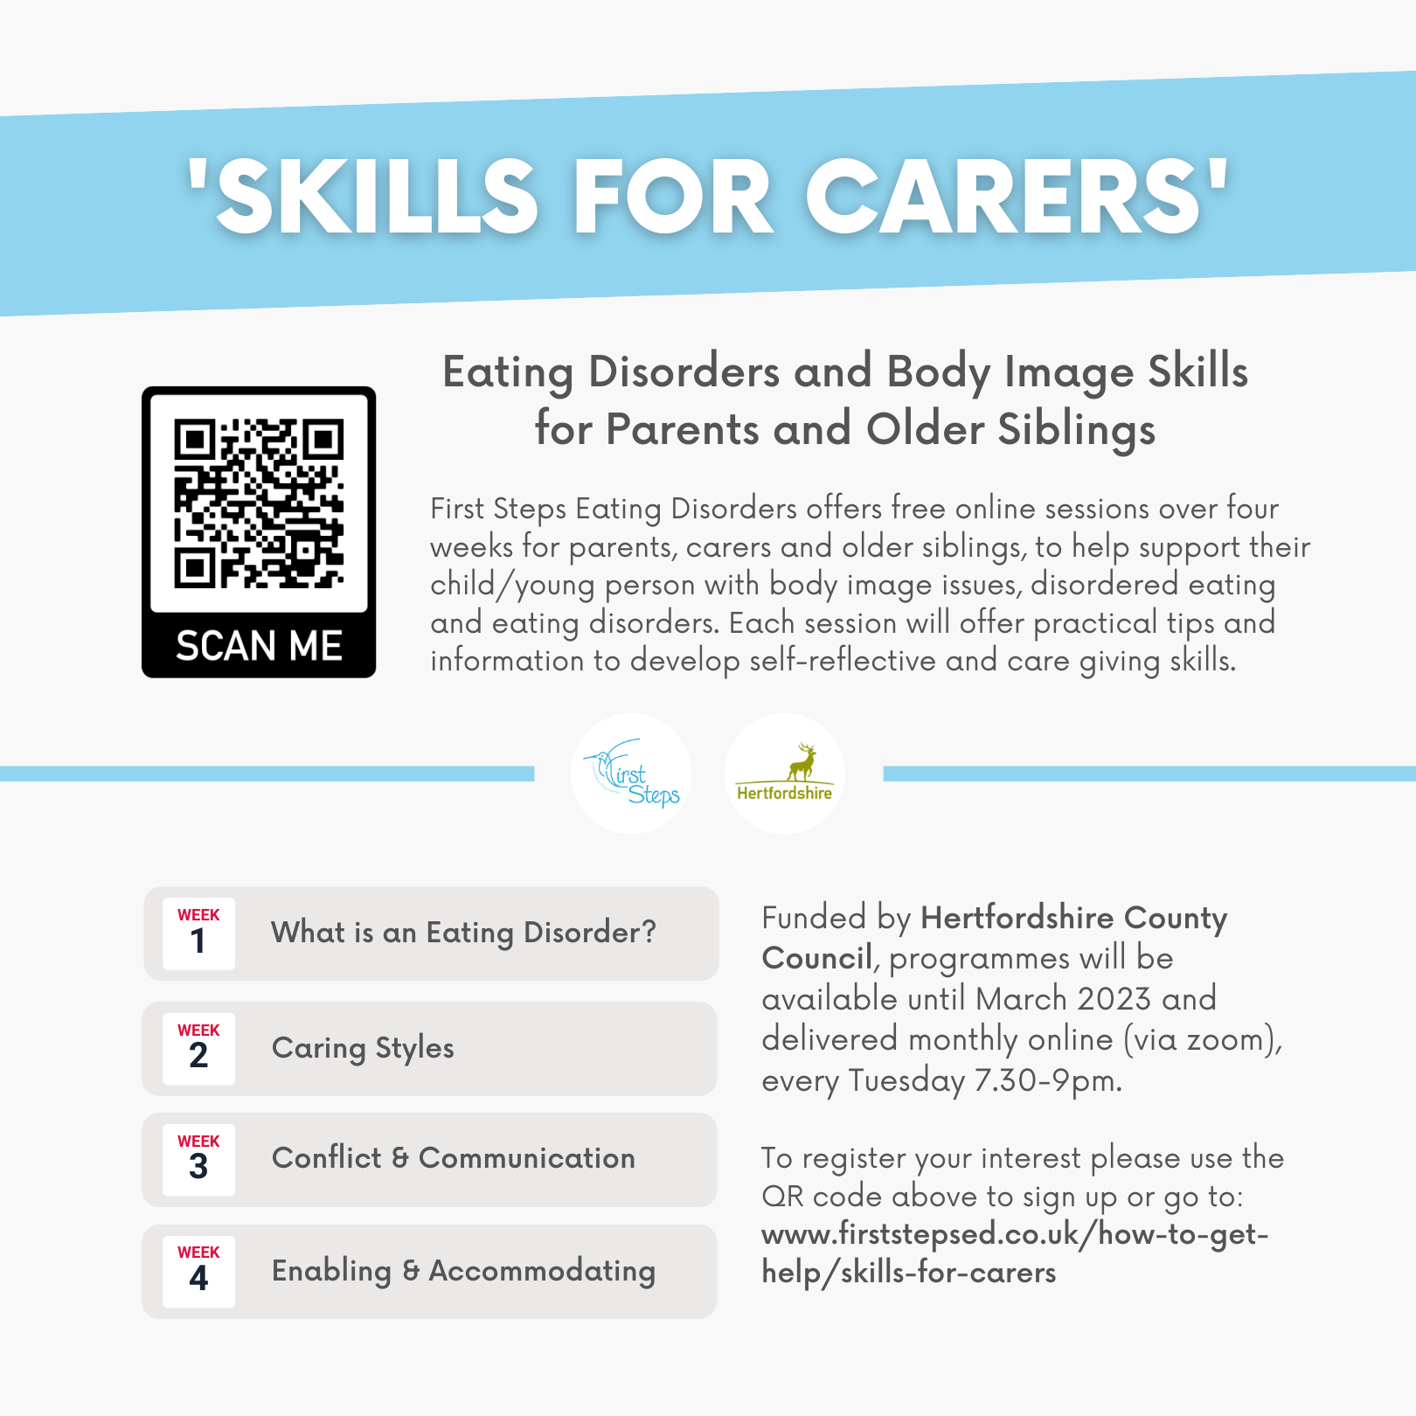
Eating Disorders and Body Image Skills from First Steps ED for Parents, Carers and Older Siblings

Slide 9
Student Space website for mental health and emotional wellbeing of Uni students
Check out www.studentspace.org.uk
for mental health & emotional wellbeing articles, blogs, tips and advice for uni students

Slide 10
Just Talk Hertfordshire website for parents and carers
Mental health & emotional wellbeing info for Hertfordshire parents and carers at:
www.justtalkherts.org

Slide 11
ChatHealth Text Messaging Service for parents and carers of children aged 0-5
Parents and carers of
0-5 year olds can get emotional health & wellbeing advice
from the Health Visiting Team via ChatHealth
text messaging service
Mon-Fri 9-5pm

Slide 12
Children’s Wellbeing Practitioner Webinar for children who are struggling to attend school due to anxiety
Get advice for young people who are struggling to attend school due to anxiety in webinar from Children’s Wellbeing Practitioners at: www.hct.nhs.uk

Slide 13
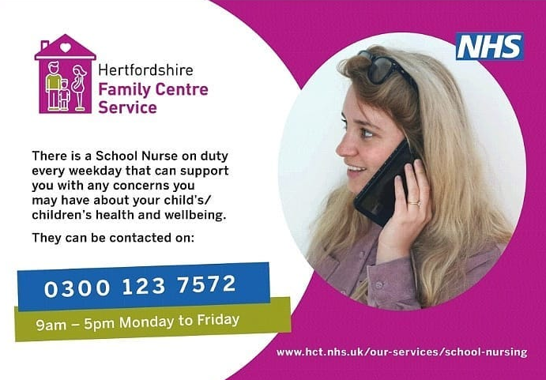
School Nursing Service number open Monday-Friday 9-5

Slide 14
Health for Kids Website for Primary School Children
Healthy body & mind topics by experts for primary school children at:
www.healthforkids.co.uk

